Slide 1
Building Reports: Efficiency Guidelines
Notes:
Delete this text before publication.
Final Edit Checklist
Delete the dashed red lines from the Master slide.
Save this file in normal slide view. Do not save with any of the Master views open.
Verify that the Help tree navigation paths in the Notes Layout are correct.
Verify that you have deleted any extra blank lines at the end of each of the notes layout pages.
Verify that you have deleted all instructional template text from the notes pages.
Schedule: Timing Topic
<xx> minutes Lecture
<xx> minutes Practice
<xx> minutes Total

Slide 2
Objectives
After completing this lesson, you should be able to
do the following:
  Describe performance areas
  Use performance measuring tools
  Build reports to run in other languages
Notes:
Lesson Aim
<Enter lesson aim here.>

Slide 3
Tuning Reports
  No absolute rules
  Investigate specific areas:
    Data Model
    Paper Layout
    Web Layout and JSP report definitions
    Run-time arguments

Slide 4
Performance Measurement
Measurement tool: Trace option
Server and network measurements:
  SQL Trace
  Traffic and bandwidth

Slide 5
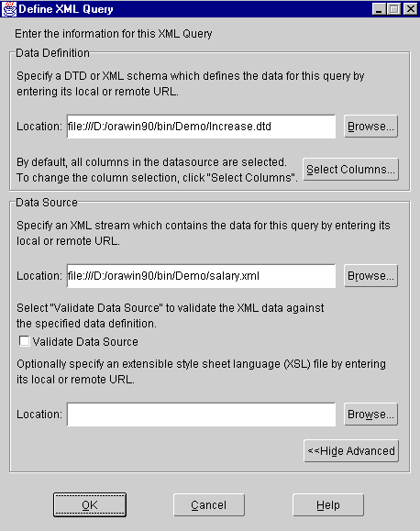
Non SQL Data Sources

Slide 6
Investigating the Data Model
  Schema design
  Indexes
  Efficient SQL
  Efficient PL/SQL
  Calculations
  Redundant queries
  Break groups
  Group filters
  Linking queries

Slide 7
Investigating the Data Model
  Schema design
  Indexes
  Efficient SQL
  Efficient PL/SQL
  Calculations
  Redundant queries
  Break groups
  Group filters
  Linking queries

Slide 8
Investigating the Paper Layout
  Frames
  Object size
  Format triggers
  Fetching ahead
  Bursting and distribution

Slide 9
Investigating the Paper Layout
  Frames
  Object size
  Format triggers
  Fetching ahead
  Bursting and distribution

Slide 10
Running the Report
  RUNDEBUG=NO
  Array processing
  LONGCHUNK
  PARAMFORM
  Batch processing

Slide 11
Different Development and Run-Time Environments
  Reports Builder development
Bitmapped only
  Reports Builder Runtime
    Bitmapped
    MODE = bitmap
    Character mode
    MODE = character

Slide 12
Developing Reports to Run in Different GUIs
  Use common fonts or map fonts in
  uifont.ali
  Use common colors
  Be aware of dots per inch (DPI)

Slide 13
Setting NLS Language Environment Variables
  NLS_LANG
  DEVELOPER_NLS_LANG, USER_NLS_LANG
Unicode:
NLS_LANG=French_France.WE8DEC
NLS_LANG=<lang>_<territory>.UTF8

Slide 14
Translating an Application
Use TranslationHub to translate messages and text defined as part of the application.
Consider:
  Format masks
  Hard-coded strings
  Multiple character sets

Slide 15
Summary
In this lesson, you should have learned how to:
  Use performance measuring tools
  Describe the facilities for running reports in other languages
Notes:
The new Reports Server provides increased efficiency and scalability for large reports.
By caching report output, you can ensure that users do not rerun reports unnecessarily.

Slide 16
Practice 22 Overview
  Identifying areas to investigate for tuning reports
  Using the trace facility
  Interpreting time statistics
  Improving performance
Notes:
The new Reports Server provides increased efficiency and scalability for large reports.
By caching report output, you can ensure that users do not rerun reports unnecessarily.

